Slide 1
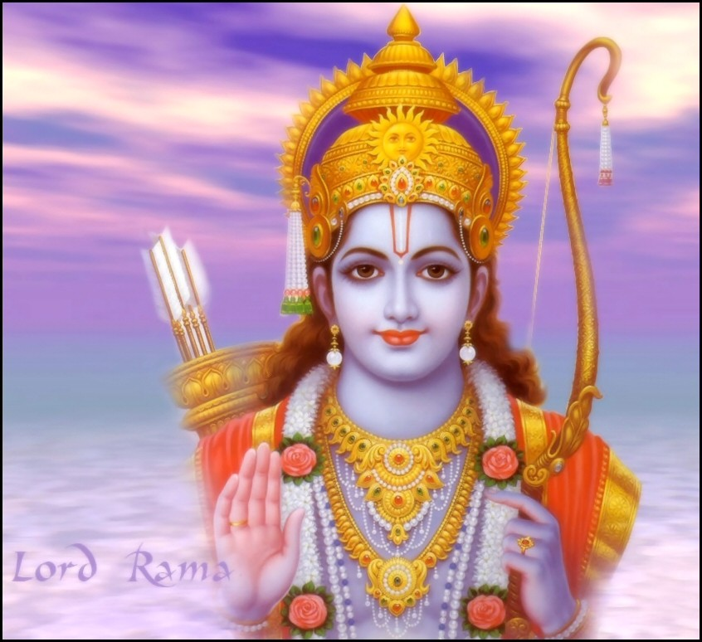
Sri Ram Navami (Birth of Lord Ram)

Slide 2
Why we celebrate Sri Ram Navami ?
SriRama Navami is a Hindu festival, celebrating the birth of Sri Ram, to King Dasharath of Ayodhya and Queen Kausalya.
Lord Sri Ram is the 7th incarnation of Lord Vishnu.
Sri Ram Navami falls on the Navami, ninth day of the Chaitra month of Vedic lunar year.

Slide 3
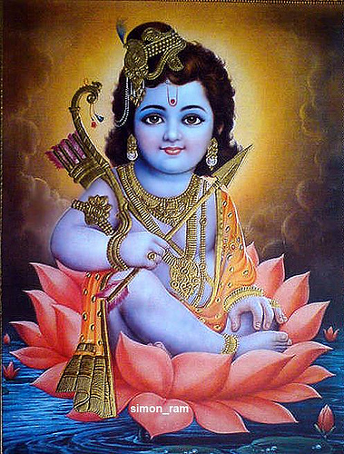
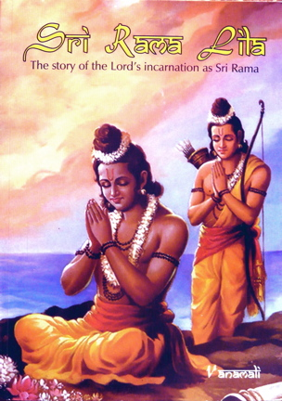
Pictures of Sri Ram as a child

Slide 4
How we Celebrate Sri Ram Navami
Sri Ram Navami is marked by continuous recitals, Akhand Paath, mostly of Sri Ram Charitmanas, with elaborate Bhajan and Kirtan singing, and distribution of Prasad after the Puja and Aarti.
Images of baby Sri Ram are placed on cradles and rocked by devotees.
In South India, the day is also celebrated as the wedding anniversary of Sri Ram and his wife Sita Devi and thus ceremonial wedding ceremonies, Sitarama Kalyanam, of the celestial couple are held at temples throughout the region.

Slide 5
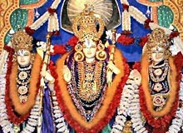
Sri Ram Navami Celebration Pictures

Slide 6
Ramayan – The Story
Ram was the first of the four sons of King Dasharatha of Ayodhya.
As the princes were growing up in Ayodhya, one day Saint Vishwamitra came and asked for Prince Ram’s help to perform his prayers as the demoness Tarka along with her sons Mareech and Subahu would not let me finish his yagna. So they accompanied him to the forest and protected his Ashram and killed the demons.
On their way back home, the Maharshi took them to the kingdom of Raja Janak who was holding the Swayamvar of his daughter, Sita.
There only Lord Ram was able to tie the string on the bow and in fact broke in half. And Lord Ram was able to earn Sita’s hand in Marriage.
When it was time for Ram to be made crown-prince, his stepmother, Kaikeyi, got Dasharatha to send him to the forest for 14 years. His wife Sita and his brother Lakshman also accompanied him. In the forest, Sita was kidnapped by Ravan, the demon king of Lanka. Ram, together with Hanuman and the monkey army, built a bridge to Lanka, killed Ravan, and brought Sita back.

Slide 7
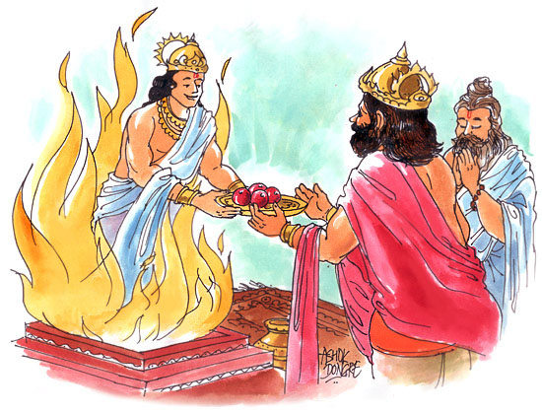
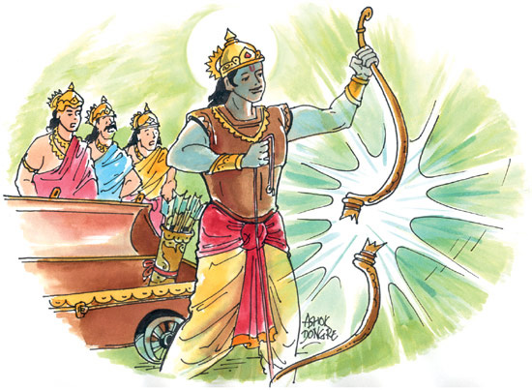
Sri Ram’s Story

Slide 8
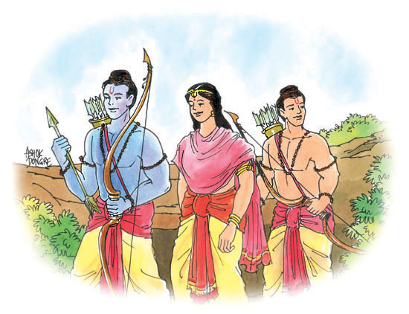
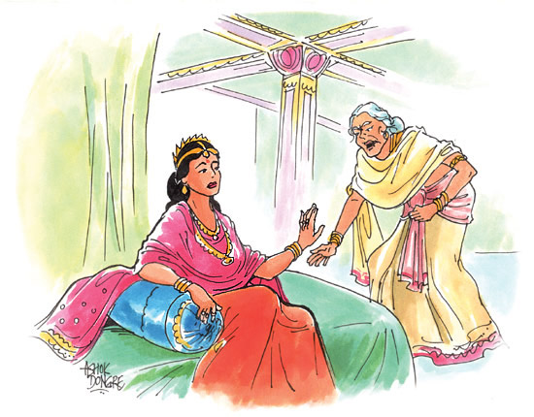
Sri Ram’s Story

Slide 9
The Holy Book Ramayan
The "Valmiki Ramayana" written in ancient Sanskrit verse by Maharshi Valmiki and the "Ram Charita Manasa" written in a popular dialect of Hindi by Goswami Tulasidas are regarded as the most original and complete versions of Ramayana.
Every direction of the righteous human life is covered in these great treatises on the character and life of Lord Sri Ram.
God's manifestation in human form as Sri Ram is a symbol of culmination of human glory.
That is why the character of Lord Sri Ram is considered to be that of “Maryaada Purushottama" - supreme glory of mankind.

